Slide 1


OCP 11 [1Z0-819]
Dr.-Ing Mohamed Amine Mezghich
Associate Professor at ENSI, CEO of Smart IT Partner
JAVA/J2EE Certified Trainer
ma.mezghich@smart-it-partner.com
amine.mezghich@ensi-uma.tn

Slide 2
Chapter 8 : IO Exam Essentials
1-Understand files, directories, and streams. Files are records that store data to a persistent storage device that is available after the application has finished executing. Files are organized within a file system in directories, which in turn may contain other directories. Files can be accessed using streams, which present the data in sequential blocks.
2-Be able to use the java.io.File class. Java File instances can be created by passing a path String to the new File() constructor. The File class includes a number of instance methods for retrieving information about both files and directories. It also includes methods to create/delete files and directories, as well as retrieve a list of files within the directory.

Slide 3
Chapter 8 : IO Exam Essentials
3-Distinguish between byte and character streams. The java.io API supports both byte and character streams. Byte streams have the word InputStream or OutputStream in their name and are useful for interacting with binary data. Character streams have the word Reader or Writer in their name and are convenient for working with String or character data. 4-Distinguish between low-level and high-level streams. A low-level stream is one that operates directly on the underlying resource, such as a stream that reads file data from the file system. A high-level stream is one that operates on a low-level or other high-level stream to filter or convert data or to improve read/write performance with the buffer.

Slide 4
Chapter 8 : IO Exam Essentials
5-Be able to recognize and know how to use the following classes: BufferedReader, BufferedWriter, File, FileReader, FileWriter, FileInputStream, FileOutputStream, ObjectOutputStream, ObjectInputStream, and PrintWriter.
The java.io API reuses terms in the stream class name, which are useful in decoding the function of the class, such as InputStream, OutputStream, Reader, Writer, Buffered, File, Object, and Print. You should know how to use the stream classes listed here, including how to chain the streams together.

Slide 5
Chapter 8 : IO Exam Essentials
6-Be able to perform common stream operations including close(), flush(), mark(), markSupported(), reset(), and skip(). The java.io API includes numerous methods common to both input and output stream classes. The close() method is shared by all stream classes and can be used implicitly by using try-with-resource syntax. The flush() method is used in output stream classes to force the writing of the data to the underlying resource. The markSupported(), mark(), and reset() methods are used in conjunction with the input stream classes to mark a position in the stream and return to it later on. Not all java.io input stream classes support the mark() and reset() operations. Finally, the skip() method is used in input stream classes to skip past a number of bytes.

Slide 6
Chapter 8 : IO Exam Essentials
7- Understand how to use Java serialization. Classes can implement the java. io.Serializable interface to indicate that they support serializing their data to disk. The interface requires that all instance members of the class are Serializable or marked transient. The String class and all Java primitives are Serializable. The ObjectInputStream and ObjectOutputStream classes can be used to read and write a Serializable object from and to a stream, respectively. 8-Be able to interact with the user via the Console class. Java 6 introduced the Console class as a replacement to System.in and System.out for reading and writing data from the user, respectively. The Console class includes special methods for retrieving passwords that are more secure than the standard ways of retrieving String values.

Slide 7
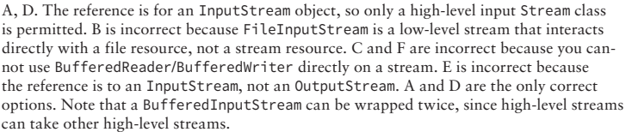
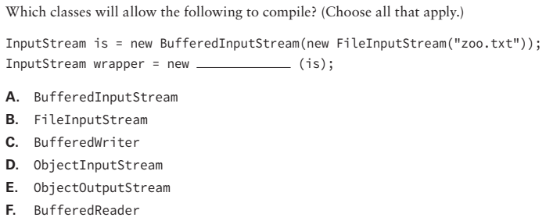
Chapter 8 : IO Review Questions
Q1)

Slide 8
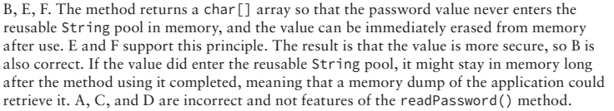
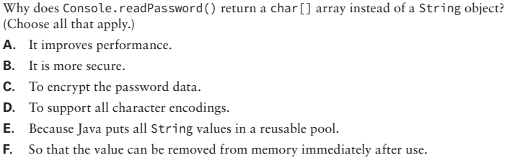
Chapter 8 : IO Review Questions
Q2)

Slide 9

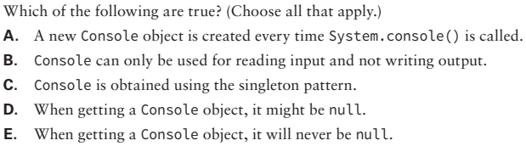
Chapter 8 : IO Review Questions
Q3)

Slide 10
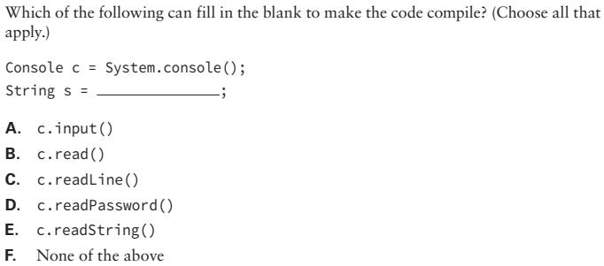
Chapter 8 : IO Review Questions
Q4)

Slide 11
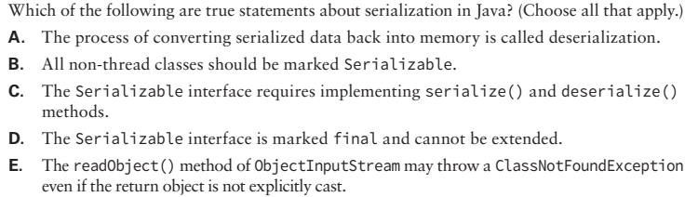
Chapter 8 : IO Review Questions
Q5)

Slide 12
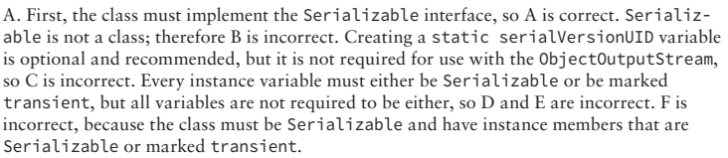
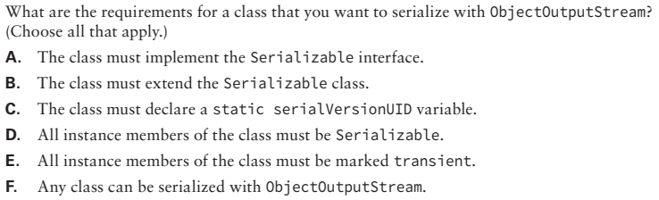
Chapter 8 : IO Review Questions
Q6)
Notes:
Q9

Slide 13
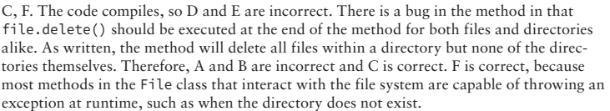
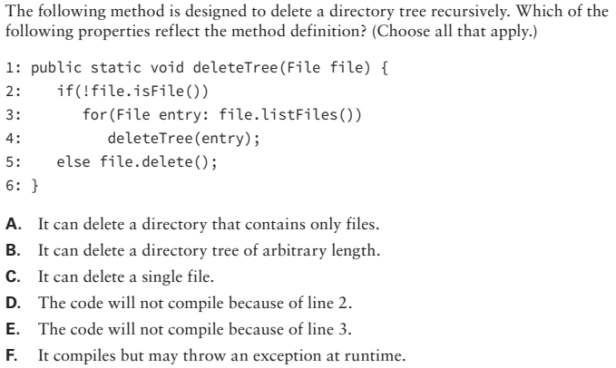
Chapter 8 : IO Review Questions
Q7)
Notes:
Q10

Slide 14
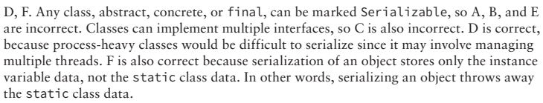
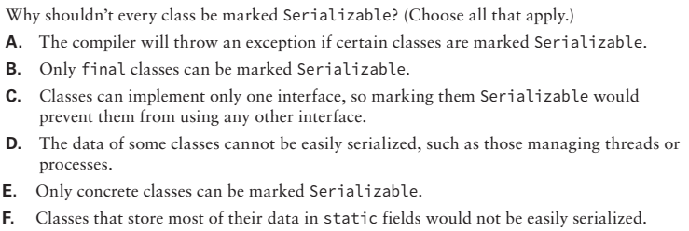
Chapter 8 : IO Review Questions
Q8)
Notes:
Q16

Slide 15
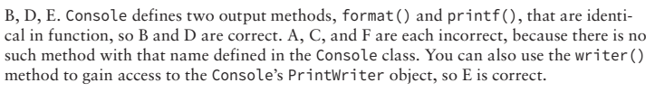
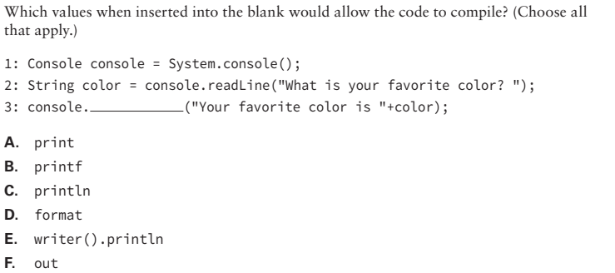
Chapter 8 : IO Review Questions
Q9)
Notes:
Q18

Slide 16
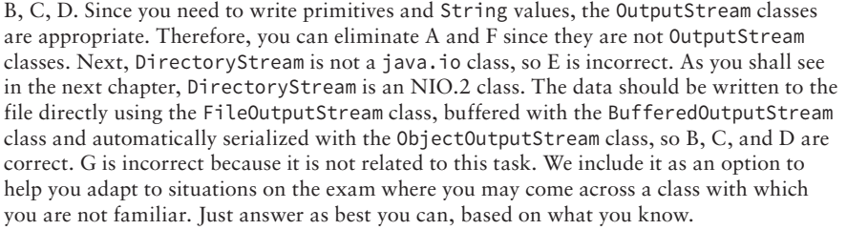
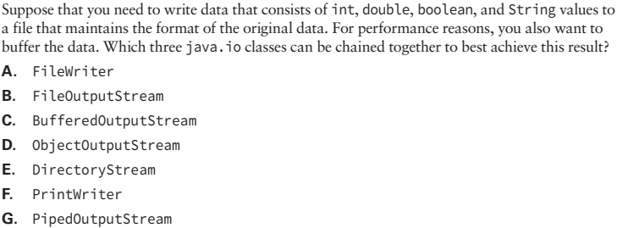
Chapter 8 : IO Review Questions
Q10)
Notes:
Q19

